Slide 1
Bike Safety Facts
Bicyclist deaths in 2012: 726 (NHTSA Traffic Safety Facts)
Bicyclist injuries in 2012: 49,000 (NHTSA Traffic Safety Facts)
In 2012, the average age of bicyclists killed in crashes with motor vehicles was 43 years old, up from 32 in 1998, and 24 in 1988.
88 percent of those killed were male.
69 percent of bicyclist fatalities occurred in urban areas.
30 percent of bicyclist fatalities occurred between 4:00 p.m. and 7:59 p.m.
24 percnet of bicyclists killed had blood alcohol concentrations of 0.08 g/dL or higher- National Highway Traffic Safety Administration
Source: http://www.pedbikeinfo.org/data/factsheet_crash.cfm#No1

Slide 2
You are the M.V.P.C.

Slide 3
7 Principles of Bicycling and Commuting
Bicyclists have the right to operate on all Nevada streets, roads, and highways, except where restricted (i.e. freeways, sidewalks)
Bicyclists should ride on the road, and must ride in the same direction as traffic.
Bicyclists must obey all traffic control signs and signals.
Motorists and bicyclists must yield the right-or-way to each other.
Bicyclists should signal their turns and ride in a predictable manner.
Bicyclists must use a headlight and rear reflectors when riding in the dark.
Always wear a helmet. Wear it properly.

Slide 4
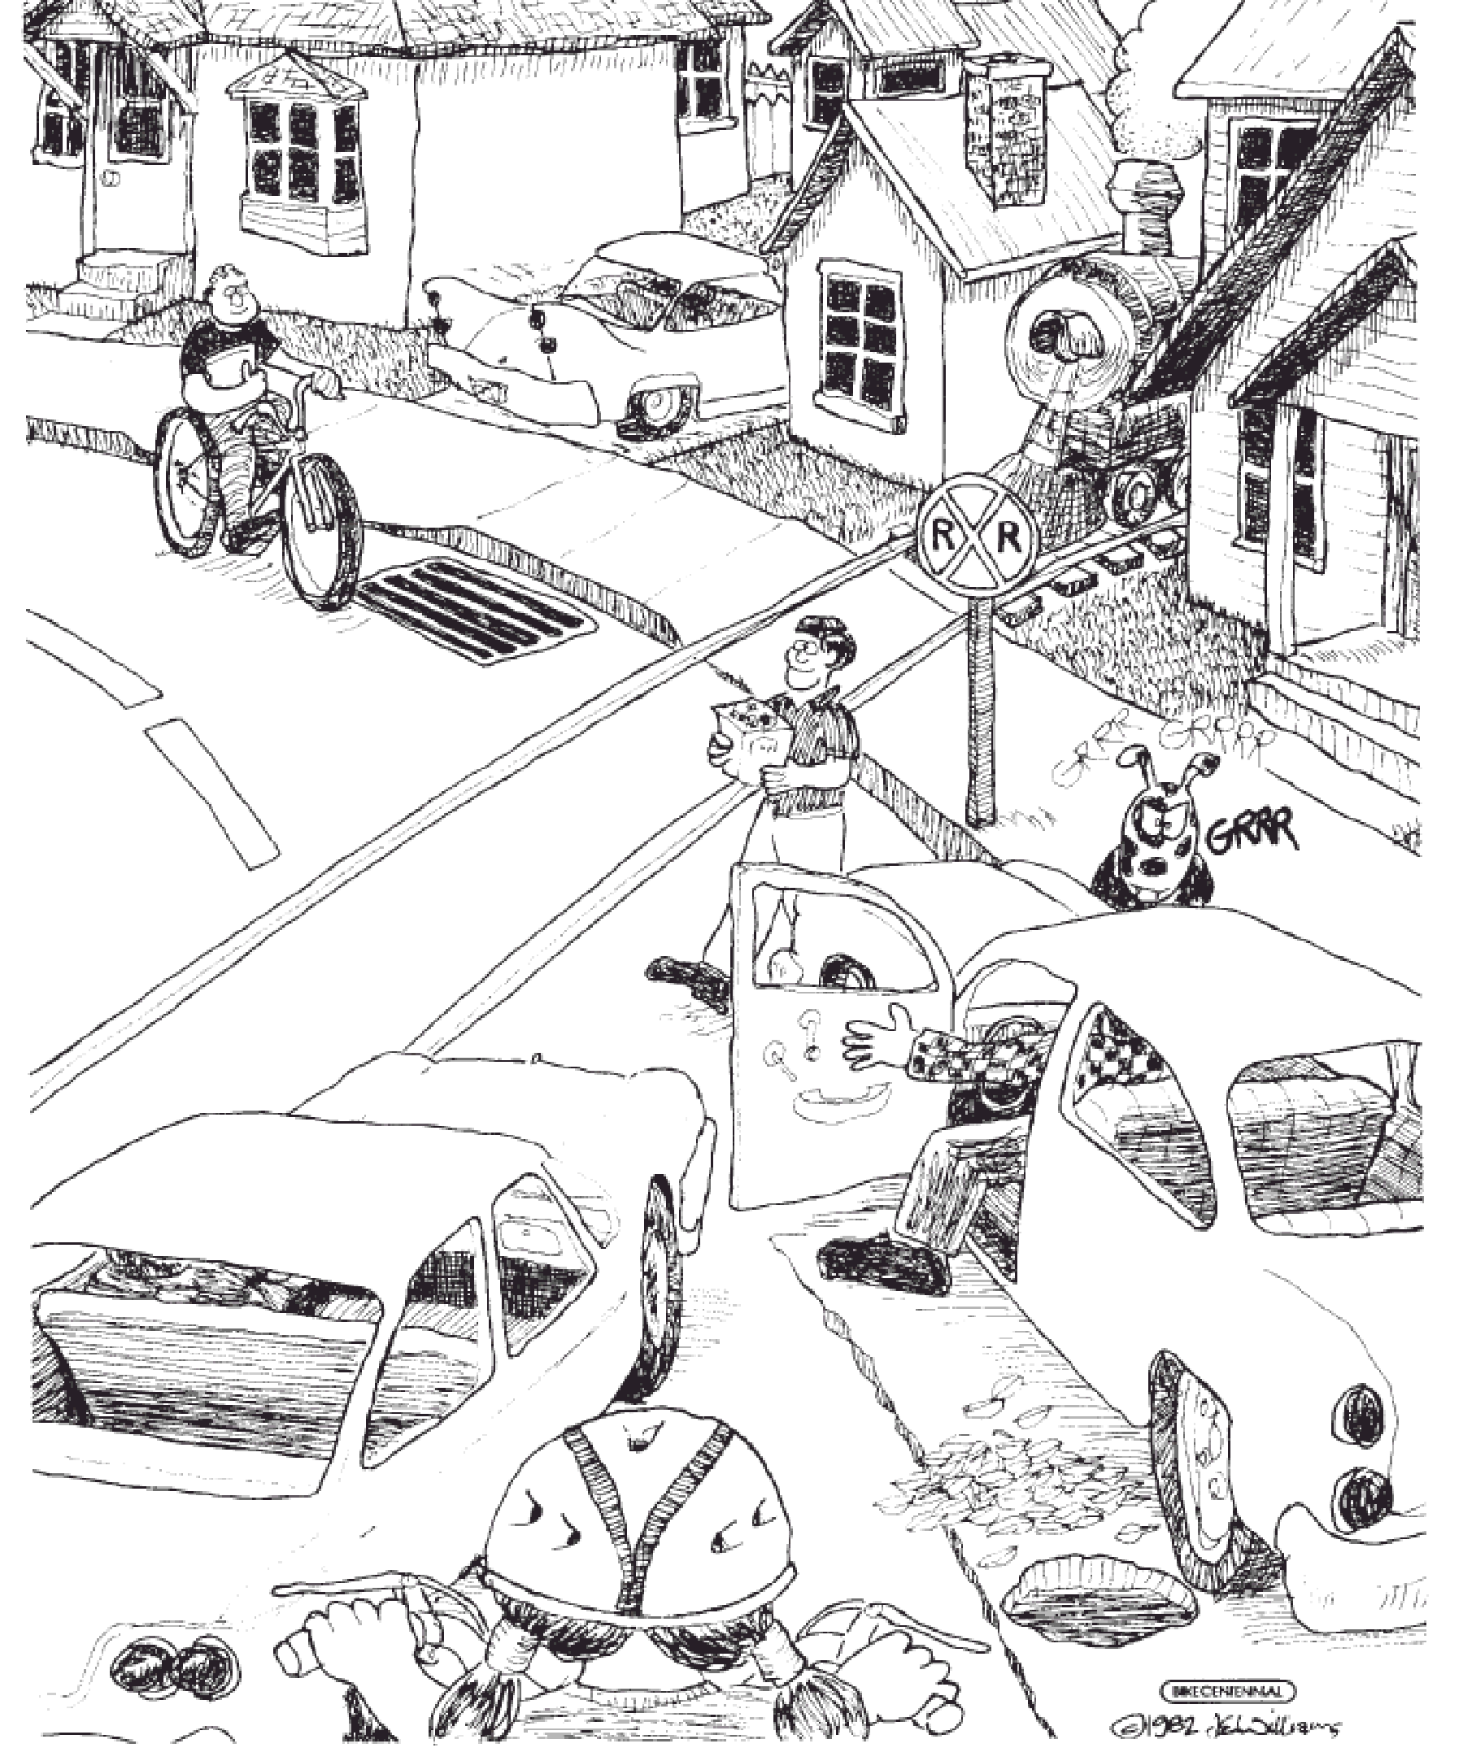

Slide 6
Route Planning
RTC Bike Map:explain legend and bike facilities on map
Demonstrate residence to employment, employment to other utilitarian travel destination such as the grocery store
Explain benefits of low stress, less car volume, parallel routes.
Demonstrate Google Map Bike Feature
https://developers.google.com/maps/documentation/javascript/examples/layer-bicycling
Have students pair up, highlight routes of residence to work and or other utilitarian destinations. Have them share with group

Slide 7
Google Maps Route Planning Layer
https://developers.google.com/maps/documentation/javascript/examples/layer-bicycling

